Slide 1
Mission DARPA: http://ccr.sigcomm.org/archive/1995/jan95/ccr-9501-clark.pdf Read the paper “DARPA” and Arrange it to page 8 for Outline.
MIR Lab

Slide 2
Outline
BG (Background)
Organize your background to read the thesis.
Research problems or questions
Organize the problem that led to your thesis.
Gap/lack of research
Find the gaps in your thesis and sort them out.
Motivation & Purpose
Organize your motive and purpose for writing your thesis.
Contribution/Solution
Write down your contributions to solve the problem in your thesis.
Result
Organize the conclusion of your thesis.
Future Work
Organize what needs to be done in your thesis.

Slide 3
Example A Hierarchical Distributed Orchestration Framework for Multi-domain SDTNs
MIR Lab

Slide 4
BG : 5G Transport Network
Consists of multiple Optical Transport Networks(OTNs)
Should be Multi-domain Networks
To achieve a scalable and confidential paradigm
Control Function can be decoupled from the data-forwarding technology
To achieve increasingly enhanced programmability and flexibility
Orchestration framework for multi-domain SDTNs is needed
Orchestration framework involves :
Discovering the network inventory
Allocating network resources
Providing end-to-end transport services with Traffic Engineering capabilities

Slide 5
Problems : Hierarchical & Distributed Orchestration
 | Hierarchical Orchestration (HO) | Distributed Orchestration (DO)
Advantage | Reduces the convergence time to synchronize the network state and the control traffic | Facilitates cooperation of multiple heterogeneous control planes and end-to-end service provisioning
Shortage | Limited scalability | Requires complex interactions for periodic state refreshes to maintain resource synchronization
→ Best combination of the two orchestration architectures is needed

Slide 6
Motivation & Purpose : Hierarchical Distributed Orchestration(HDO)
Combines the advantages of the HO and DO
Design and Analysis of the proposed framework architecture
Using northbound/southbound interfaces
Using eastbound/westbound interfaces
Enables distributed per-domain path computation and provisioning control with abstracted visibility of the entire network topology

Slide 7
Contribution
Evaluation of :
Topology discovery and updating time
Path computation burden
Provisioning delay
Demonstrates improvements of proposed framework :
Scalability
Robustness
stability

Slide 8
Proposed Solution : Orchestration Framework Architecture
HDO framework consists of a parent orchestrator(PO) and a set of child orchestrators(COs)
May have more than two layers
Recursively define a PO layer and CO layer
Decoupled architecture make finer control and flexibility

Slide 9
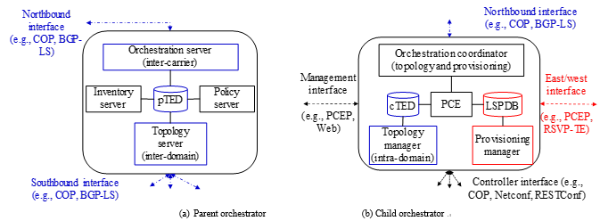
Proposed Solution : Orchestration Entitles
Orchestration framework is represented by the multiple orchestration entitles
Key functions (potentially integrate with transport resources) :
Topology discovery and monitoring
End-to-end path computation
Path provisioning
PO is orchestration server or “orchestrator of orchestrator”
Function used to enforce service policies applicable to network component/attribute data
CO is orchestration coordinator or a centralized “orchestrator of controllers”
→ Combined with orchestration coordinator, topology manager, PCE, provisioning manager, TED, LSP Database(LSPDB)

Slide 10
Proposed Solution : Orchestrator Interfaces
Orchestrator is connected to others via multiple interfaces
Controller interface
Underlying controller abstracts the particular control plane functions of a given domain
Eastbound/westbound interface
CO enables connectivity provisioning covering inter-domain aspects
Used to exchange the provisioning requests and results
Northbound/southbound interface
PO collects abstract topology
CO proactively retrieves the abstract inter-domain topology
CO reactively updates the topology and the TE information
Decomposed interfaces are technology and function dependent
Advantage :
Robustness
Stability
Optimization

Slide 11
Proposed Solution : Protocols
Topology Discovery and Updating Protocol (G-TOPN)
Proactive intra-domain topology discovery process
CO Collects the network topology from the controllers
Proactive inter-domain topology discovery process
CO builds an abstract inter-domain network topology and its connectivity
Reactive topology updating process
Cos can reactively maintain inter-domain network topology and inter-domain connectivity
Path Computation and Provisioning Protocol (G-TOPE)
CO computes an end-to-end path and initiates the LSPs over the underlying transport networks
CO independently computes the complete sequence of domains to reach the destination
G-TOPE is specialized for per-domain provisioning
Enables operators to automate the connectivity provisioning at ingress Cos

Slide 12
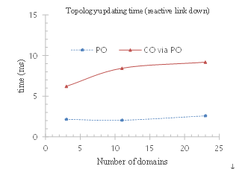
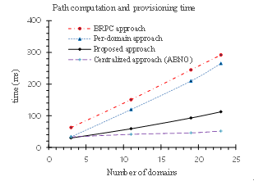
Proposed Solution: Test Results
Topology update time for proposed approach and the HO approach for comparison
Proposed protocol slightly increases the additional delay
Negligible compared to the convergence time of the IGP routing approach
Event notification information enables all COs to update information within 10ms in the experiments
→ Means proposed approach can take advantage of the hierarchical approach for maintaining the network topology compared to the DO approach.
Path provisioning time including the path computation time for the HO,DO, proposed HDO approach
HDO approach considerably reduces the provisioning time
→ Reflects the effectiveness of the proposed protocol

Slide 13
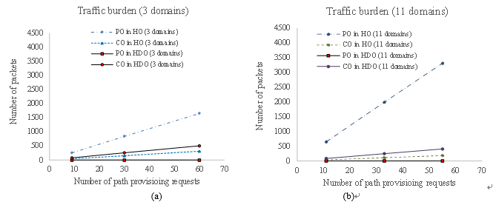
Proposed Solution: Test Results
Path-provisioning burden on the PO and COs while provisioning requests increase
HO approach increases the control traffic over the PO
Proposed framework reduces the burden by evenly distributing it among all COs
Distributed load balancing effect is increased and avoids scalability issues for the centralized PO in the HO approach

Slide 14
Results
Parallel approach seems more efficient than serialized operation
CO can be considered as a distributed autonomous orchestrator
Serves as a separate routing and signaling controller
Enables network operators to deploy service features

Slide 15
Meaning of Result
Proposed framework can provide a single CO as an autonomous orchestrator for the purposes of :
Network resource discovery
Topology management
Connectivity provisioning
Monitoring
Proposed framework significantly eliminates the provisioning burden over the centralized PO
Proposed framework architecture has advantages in terms of
Scalability
Flexibility
Efficiency
confidentiality

Slide 16
Future Works
Not founded

